Slide 1


HTML Basic
HTML Introduction

Slide 2
Information
Agenda
System
01
HTML <body> section
Some basic tags in <body>
02
HTML Tables
Managing Tables
03
HTML Forms
Managing Forms
04
HTML Frames
Managing Frames

Slide 3
HTML <body> Section
Some basic tags in <body>

Slide 4
<body> Section: Introduction
The <body> section describes the viewable portion of the page
Starts after the <head> </head> section
Begins with <body> and ends with </body>
<html>
<head><title>Test page</title></head>
<body>
<!-- This is the Web page body -->
</body>
</html>

Slide 5
Text Formatting
Text formatting tags modify the text between the opening tag and the closing tag
  Ex. <b>Hello</b> makes “Hello” bold
<b></b> | bold
<i></i> | italicized
<u></u> | underlined
<sup></sup> | Sample^{superscript}
<sub></sub> | Sample_{subscript}
<strong></strong> | strong
<em></em> | emphasized
<pre></pre> | Preformatted text
<blockquote></blockquote> | Quoted text block
<del></del> | Deleted text – strike through
5

Slide 6
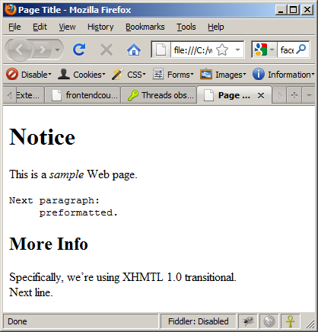
Text Formatting – Example
text-formatting.html
<!DOCTYPE html PUBLIC "-//W3C//DTD XHTML 1.0 Transitional//EN"
"http://www.w3.org/TR/xhtml1/DTD/xhtml1-transitional.dtd">
<html>
<head>
<title>Page Title</title>
</head>
<body>
<h1>Notice</h1>
<p>This is a <em>sample</em> Web page.</p>
<p><pre>Next paragraph:
preformatted.</pre></p>
<h2>More Info</h2>
<p>Specifically, we're using XHMTL 1.0 transitional.<br />
Next line.</p>
</body>
</html>

Slide 7
Hyperlinks: <a> Tag
Create parent.html. Link to a document called form.html on the same server in the same directory:
Create form.html on the same server :
Create folder inside and create child.html. Link to a document called parent.html on the same server in the parent directory:
<a href="form.html">Fill Our Form</a>
<a href="inside/child.html">Go to Child</a>
<p> form 1 </p>
<p> child </p>
<a href="../parent.html">Parent</a>

Slide 8
Hyperlinks: <a> Tag (2)
Link to an external Web site:
  Always use a full URL, including "http://", not just "www.somesite.com"
  Using the target="_blank" attribute opens the link in a new window
  Other values are :
    _parent (open in the parent frame),
    _self (open in the current frame),
    _top (open in the most top frame),
    frame name (select proper name)
Link to an e-mail address:
<a href="http://www.google.com" target="_blank">Google</a>
<a href="mailto:bugs@example.com?subject=Bug+Report">
Please report bugs here (by e-mail only)</a>

Slide 9
Hyperlinks and Sections
Link to another location in the same document:
Link to a specific location in another document:
<a href="#section1">Go to Introduction</a>
...
<h2 id="section1">Introduction</h2>
<a href="chapter3.html#section3.1.1">Go to Section 3.1.1</a>
<!–- In chapter3.html -->
...
<div id="section3.1.1">
<h3>3.1.1. Technical Background</h3>
</div>

Slide 10
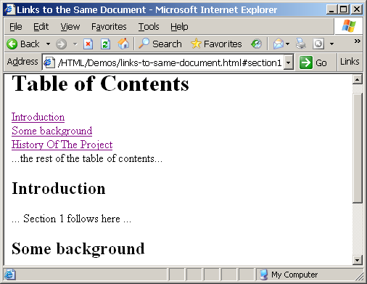
Links to the Same Document – Example
links-to-same-document.html
<h1>Table of Contents</h1>
<p><a href="#section1">Introduction</a><br />
<a href="#section2">Some background</A><br />
<a href="#section2.1">Project History</a><br />
...the rest of the table of contents...
<!-- The document text follows here -->
<h2 id="section1">Introduction</h2>
... Section 1 follows here ...
<h2 id="section2">Some background</h2>
... Section 2 follows here ...
<h3 id="section2.1">Project History</h3>
... Section 2.1 follows here ...

Slide 11
Images: <img> tag
Inserting an image with <img> tag:
Image attributes:
Example:
<img src="/img/logo.png">
src | Location of image file (relative or absolute)
alt | Substitute text for display (e.g. in text mode)
height | Number of pixels of the height
width | Number of pixels of the width
border | Size of border, 0 for no border
<img src="./php.png" alt="PHP Logo" />
11

Slide 12
Miscellaneous Tags
<hr />: Draws a horizontal rule (line):
<center></center>: Deprecated!
<font></font>: Deprecated!
<hr size="5" width="70%" />
<center>Hello World!</center>
<font size="3" color="blue">Font3</font>
<font size="+4" color="blue">Font+4</font>

Slide 13
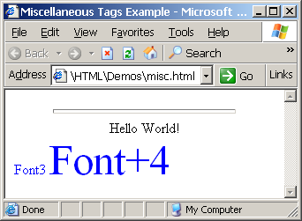
Miscellaneous Tags – Example
misc.html
<html>
<head>
<title>Miscellaneous Tags Example</title>
</head>
<body>
<hr size="5" width="70%" />
<center>Hello World!</center>
<font size="3" color="blue">Font3</font>
<font size="+4" color="blue">Font+4</font>
</body>
</html>

Slide 14
Ordered Lists: <ol> Tag
Create an Ordered List using <ol></ol>:
Attribute values for type are 1, A, a, I, or i
<ol type="1">
<li>Apple</li>
<li>Orange</li>
<li>Grapefruit</li>
</ol>
Apple
Orange
Grapefruit
Apple
Orange
Grapefruit
Apple
Orange
Grapefruit
Apple
Orange
Grapefruit
Apple
Orange
Grapefruit

Slide 15
Unordered Lists: <ul> Tag
Create an Unordered List using <ul></ul>:
Attribute values for type are:
  disc, circle or square
<ul type="disk">
<li>Apple</li>
<li>Orange</li>
<li>Grapefruit</li>
</ul>
Apple
Orange
Pear
Apple
Orange
Pear
Apple
Orange
Pear

Slide 16
Definition lists: <dl> tag
Create Definition Lists using <dl>
  Pairs of text and associated definition;
    text is in <dt> tag,
    definition in <dd> tag
  Renders without bullets
  Definition is indented
<dl>
  <dt>HTML</dt>
  <dd>A markup language …</dd>
  <dt>CSS</dt>
  <dd>Language used to …</dd>
</dl>

Slide 17
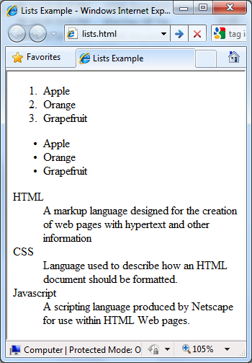
Lists – Example
lists.html
<ol type="1">
<li>Apple</li>
<li>Orange</li>
<li>Grapefruit</li>
</ol>
<ul type="disc">
<li>Apple</li>
<li>Orange</li>
<li>Grapefruit</li>
</ul>
<dl>
<dt>HTML</dt>
<dd>A markup language designed for the creation of web pages with hypertext</dd>
</dl>

Slide 18
HTML Special Characters
Symbol Name
HTML Entity
Symbol
Copyright Sign
&copy;
©
Registered Trademark Sign
&reg;
®
Trademark Sign
&trade;
™
Less Than
&lt;
<
Greater Than
&gt;
>
Ampersand
&amp;
&
Non-breaking Space
&nbsp;
Em Dash
&mdash;
—
Quotation Mark
&quot;
"
Euro
&#8364;
€
British Pound
&pound;
£
Japanese Yen
&yen;
¥

Slide 19
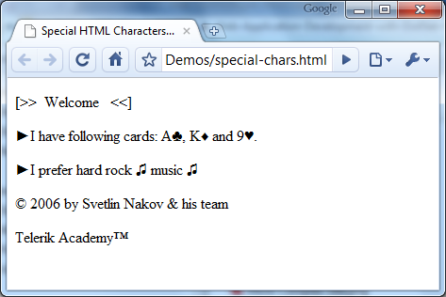
Special Characters – Example
special-chars.html
<p>[&gt;&gt;&nbsp;&nbsp;Welcome
&nbsp;&nbsp;&lt;&lt;]</p>
<p>&#9658;I have following cards:
A&#9827;, K&#9830; and 9&#9829;.</p>
<p>&#9658;I prefer hard rock &#9835;
music &#9835;</p>
<p>&copy; 2006 by Svetlin Nakov &amp; his team</p>
<p>Telerik Academy™</p>

Slide 20
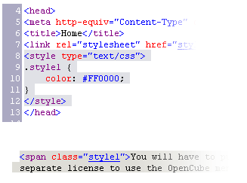

Using <DIV> and <SPAN> Block and Inline Elements

Slide 21
Block and Inline Elements
Block elements add a line break before and after them
  <div> is a block element
  Other block elements are <table>, <hr>, headings, lists, <p> and etc.
Inline elements don’t break the text before and after them
  <span> is an inline element
  Most HTML elements are inline, e.g. <a>

Slide 22
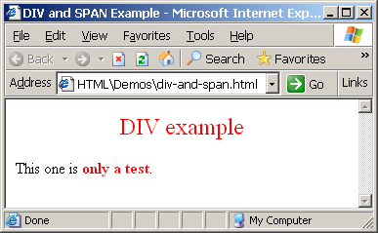
The <div> Tag
<div> creates logical divisions within a page
Block style element
Used with CSS
Example:
div-and-span.html
<div style="font-size:24px; color:red" align="center">DIV example</div>
<p>This one is <span style="color:red; font-weight:bold">only a test</span>.</p>

Slide 23
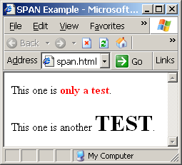
The <span> Tag
Inline style element
Useful for modifying a specific portion of text
  Don't create a separate area (paragraph) in the document
Very useful with CSS
span.html
<p>This one is <span style="color:red; font-weight:bold">only a test</span>.</p>
<p>This one is another <span style="font-size:32px; font-weight:bold">TEST</span>.</p>

Slide 24
HTML Tables
Managing Tables

Slide 25
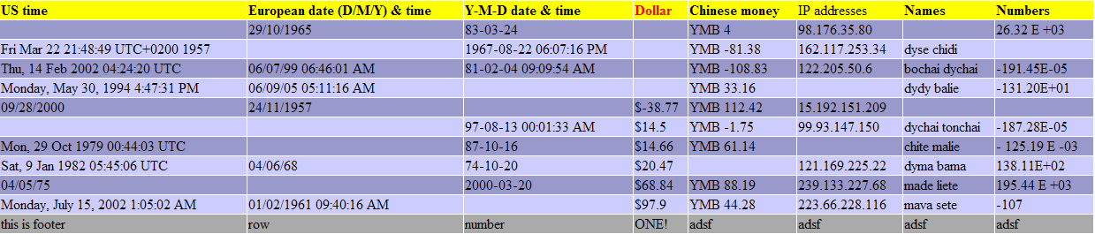
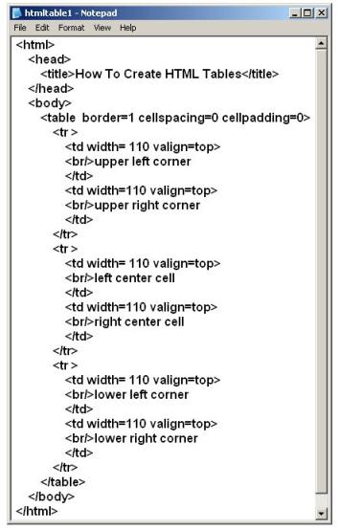
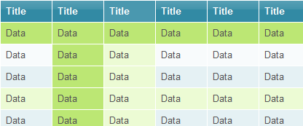
HTML Tables

Slide 26
HTML Tables
Tables represent tabular data
  A table consists of one or several rows
  Each row has one or more columns
Tables comprised of several core tags: <table></table>: begin / end the table
<tr></tr>: create a table row
<td></td>: create tabular data (cell)
Tables should not be used for layout. Use CSS floats and positioning styles instead

Slide 27
HTML Tables (2)
Start and end of a table
Start and end of a row
Start and end of a cell in a row
<table> ... </table>
<tr> ... </tr>
<td> ... </td>

Slide 28
Simple HTML Tables – Example
<table cellspacing="0" cellpadding="5">
<tr>
<td><img src="ppt.gif"></td>
<td><a href="lecture1.ppt">Lecture 1</a></td>
</tr>
<tr>
<td><img src="ppt.gif"></td>
<td><a href="lecture2.ppt">Lecture 2</a></td>
</tr>
<tr>
<td><img src="zip.gif"></td>
<td><a href="lecture2-demos.zip">
Lecture 2 - Demos</a></td>
</tr>
</table>

Slide 29
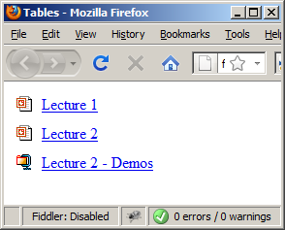
Simple HTML Tables – Example (2)
<table cellspacing="0" cellpadding="5">
<tr>
<td><img src="ppt.gif"></td>
<td><a href="lecture1.ppt">Lecture 1</a></td>
</tr>
<tr>
<td><img src="ppt.gif"></td>
<td><a href="lecture2.ppt">Lecture 2</a></td>
</tr>
<tr>
<td><img src="zip.gif"></td>
<td><a href="lecture2-demos.zip">
Lecture 2 - Demos</a></td>
</tr>
</table>

Slide 30
Complete HTML Tables
Table rows split into three semantic sections: header, body and footer
  <thead> denotes table header and contains <th> elements, instead of <td> elements
  <tbody> denotes collection of table rows that contain the very data
  <tfoot> denotes table footer but comes BEFORE the <tbody> tag
  <colgroup> and <col> define columns (most often used to set column widths)

Slide 31
Complete HTML Table: Example
<table border=1 >
<colgroup>
<col style="width:100px" /><col />
</colgroup>
<thead>
<tr><th>Column 1</th><th>Column 2</th></tr>
</thead>
<tfoot>
<tr><td>Footer 1</td><td>Footer 2</td></tr>
</tfoot>
<tbody>
<tr><td>Cell 1.1</td><td>Cell 1.2</td></tr>
<tr><td>Cell 2.1</td><td>Cell 2.2</td></tr>
</tbody>
</table>
columns
header
th
footer
Last comes the body (data)

Slide 32
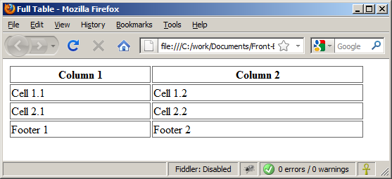
Complete HTML Table: Example (2)
By default, header text is bold and centered.
table-full.html
<table border=1 >
<colgroup>
<col style="width:200px" /><col />
</colgroup>
<thead>
<tr><th>Column 1</th><th>Column 2</th></tr>
</thead>
<tfoot>
<tr><td>Footer 1</td><td>Footer 2</td></tr>
</tfoot>
<tbody>
<tr><td>Cell 1.1</td><td>Cell 1.2</td></tr>
<tr><td>Cell 2.1</td><td>Cell 2.2</td></tr>
</tbody>
</table>
Although the footer is before the data in the code, it is displayed last

Slide 33
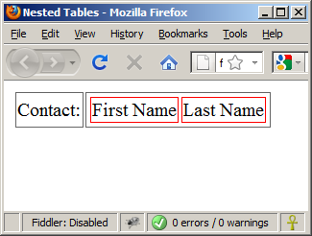
Nested Tables
Table data “cells” (<td>) can contain nested tables (tables within tables):
nested-tables.html
<table>
<tr>
<td>Contact:</td>
<td>
<table border=1 >
<tr>
<td>First Name</td>
<td>Last Name</td>
</tr>
</table>
</td>
</tr>
</table>

Slide 34
Cell Spacing and Padding
Tables have two important attributes:
cellspacing
Defines the empty space between cells
cellpadding
Defines the empty space around the cell content
cell
cell
cell
cell
cell
cell
cell
cell

Slide 35
Cell Spacing and Padding – Example
table-cells.html
<html>
<head><title>Table Cells</title></head>
<body>
<table cellspacing="15" cellpadding="0" border=1 >
<tr><td>First</td>
<td>Second</td></tr>
</table>
<br/>
<table cellspacing="0" cellpadding="10" border=1 >
<tr><td>First</td><td>Second</td></tr>
</table>
</body>
</html>

Slide 36
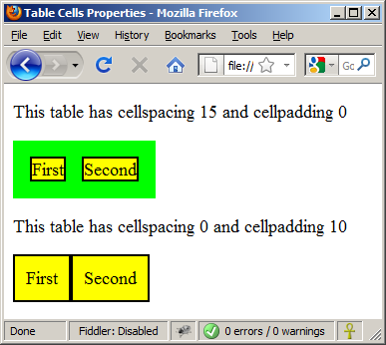
Cell Spacing and Padding – Example (2)
table-cells.html
<html>
<head><title>Table Cells</title></head>
<body>
<table cellspacing="15" cellpadding="0" border=1 >
<tr><td>First</td>
<td>Second</td></tr>
</table>
<br/>
<table cellspacing="0" cellpadding="10" border=1 >
<tr><td>First</td><td>Second</td></tr>
</table>
</body>
</html>

Slide 37
Column and Row Span
Table cells have two important attributes:
colspan
Defines how many columns the cell occupies
rowspan
Defines how many rows the cell occupies
colspan="1"
colspan="1"
rowspan="2"
rowspan="1"
cell[1,1]
cell[1,2]
cell[1,1]
cell[1,2]
cell[2,1]
cell[2,1]
colspan="2"
rowspan="1"

Slide 38
Column and Row Span – Example
table-colspan-rowspan.html
<table cellspacing="0" border=1>
<tr class="1"><td>Cell[1,1]</td>
<td colspan="2">Cell[2,1]</td></tr>
<tr class="2"><td>Cell[1,2]</td>
<td rowspan="2">Cell[2,2]</td>
<td>Cell[3,2]</td></tr>
<tr class="3"><td>Cell[1,3]</td>
<td>Cell[2,3]</td></tr>
</table>

Slide 39
Column and Row Span – Example (2)
table-colspan-rowspan.html
<table cellspacing="0" border=1 >
<tr class="1"><td>Cell[1,1]</td>
<td colspan="2">Cell[2,1]</td></tr>
<tr class="2"><td>Cell[1,2]</td>
<td rowspan="2">Cell[2,2]</td>
<td>Cell[3,2]</td></tr>
<tr class="3"><td>Cell[1,3]</td>
<td>Cell[2,3]</td></tr>
</table>
Cell[1,1]
Cell[2,1]
Cell[1,2]
Cell[2,2]
Cell[3,2]
Cell[1,3]
Cell[2,3]

Slide 40
HTML Forms
Managing Forms

Slide 41
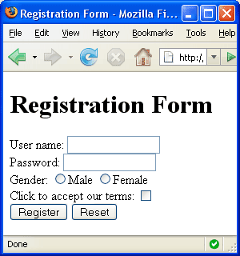


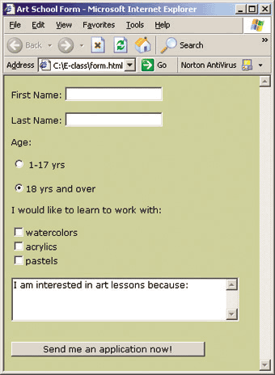
HTML Forms
Entering User Data from a Web Page

Slide 42
HTML Forms
Forms are the primary method for gathering data from site visitors
Create a form block with
Example:
<form></form>
The "method" attribute tells how the form data should be sent – via GET or POST request
<form name="myForm" method="post" action="path/to/some-script.html">
...
</form>
The "action" attribute tells where the form data should be sent

Slide 43
Form Fields
Single-line text input fields:
Multi-line textarea fields:
Hidden fields contain data not shown to the user:
  Often used by JavaScript code
<input type="text" name="FirstName" value="This is a text field" />
<textarea name="Comments">This is a multi-line text field</textarea>
<input type="hidden" name="Account" value="This is a hidden text field" />

Slide 44
Fieldsets
Fieldsets are used to enclose a group of related form fields:
The <legend> is the fieldset's title.
<form method="post" action="form.aspx">
<fieldset>
<legend>Client Details</legend>
<input type="text" id="Name" />
<input type="text" id="Phone" />
</fieldset>
<fieldset>
<legend>Order Details</legend>
<input type="text" id="Quantity" />
<textarea cols="40" rows="10"
id="Remarks"></textarea>
</fieldset>
</form>

Slide 45
Form Input Controls
Checkboxes:
Radio buttons:
Radio buttons can be grouped, allowing only one to be selected from a group:
<input type="checkbox" name="fruit" value="apple" />
<input type="radio" name="title" value="Mr." />
<input type="radio" name="city" value="Lom" />
<input type="radio" name="city" value="Ruse" />

Slide 46
Other Form Controls
Dropdown menus:
Submit button:
<select name="gender">
<option value="Value 1"
selected="selected">Male</option>
<option value="Value 2">Female</option>
<option value="Value 3">Other</option>
</select>
<input type="submit" name="submitBtn" value="Apply Now" />

Slide 47
Other Form Controls (2)
Reset button – brings the form to its initial state
Image button – acts like submit but image is displayed and click coordinates are sent
Ordinary button – used for Javascript, no default action
<input type="reset" name="resetBtn" value="Reset the form" />
<input type="image" src="submit.gif" name="submitBtn" alt="Submit" />
<input type="button" value="click me" />

Slide 48
Other Form Controls (3)
Password input – a text field which masks the entered text with * signs
Multiple select field – displays the list of items in multiple lines, instead of one
<input type="password" name="pass" />
<select name="products" multiple="multiple">
<option value="Value 1"
selected="selected">keyboard</option>
<option value="Value 2">mouse</option>
<option value="Value 3">speakers</option>
</select>

Slide 49
Other Form Controls (4)
File input – a field used for uploading files
  When used, it requires the form element to have a specific attribute:
<input type="file" name="photo" />
<form enctype="multipart/form-data">
...
<input type="file" name="photo" />
...
</form>
*For uploading files, there would be other codes to deal with server-based scripting

Slide 50
Labels
Form labels are used to associate an explanatory text to a form field using the field's ID.
Clicking on a label focuses its associated field (checkboxes are toggled, radio buttons are checked)
Labels are both a usability and accessibility feature and are required in order to pass accessibility validation.
<label for="fn">First Name</label>
<input type="text" id="fn" />

Slide 51
HTML Forms – Example
form.html
<form method="post" action="apply-now.php">
<input name="subject" type="hidden" value="Class" />
<fieldset><legend>Academic information</legend>
<label for="degree">Degree</label>
<select name="degree" id="degree">
<option value="BA">Bachelor of Art</option>
<option value="BS">Bachelor of Science</option>
<option value="MBA" selected="selected">Master of
Business Administration</option>
</select>
<br />
<label for="studentid">Student ID</label>
<input type="password" name="studentid" />
</fieldset>
<fieldset><legend>Personal Details</legend>
<label for="fname">First Name</label>
<input type="text" name="fname" id="fname" />
<br />
<label for="lname">Last Name</label>
<input type="text" name="lname" id="lname" />

Slide 52
HTML Forms – Example (2)
form.html (continued)
<br />
Gender:
<input name="gender" type="radio" id="gm" value="m" />
<label for="gm">Male</label>
<input name="gender" type="radio" id="gf" value="f" />
<label for="gf">Female</label>
<br />
<label for="email">Email</label>
<input type="text" name="email" id="email" />
</fieldset>
<p>
<textarea name="terms" cols="30" rows="4"
readonly="readonly">TERMS AND CONDITIONS...</textarea>
</p>
<p>
<input type="submit" name="submit" value="Send Form" />
<input type="reset" value="Clear Form" />
</p>
</form>

Slide 53
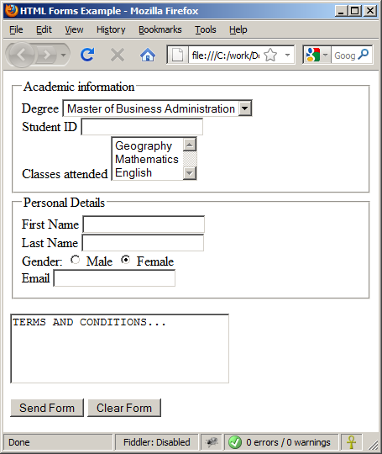
HTML Forms – Example (3)
form.html (continued)

Slide 54
HTML Frames
Managing Frames

Slide 55
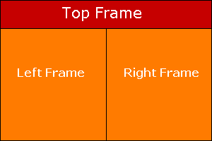
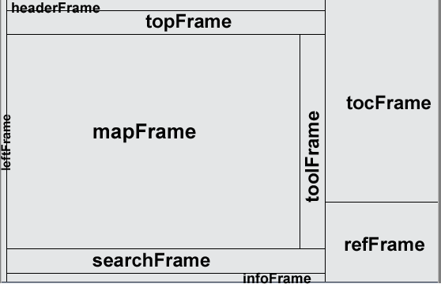
HTML Frames
<frameset>, <frame> and <iframe>

Slide 56
HTML Frames
Frames provide a way to show multiple HTML documents in a single Web page
The page can be split into separate views (frames) horizontally and vertically
Frames were popular in the early ages of HTML development, but now their usage is rejected
Frames are not supported by all user agents (browsers, search engines, etc.)
  A <noframes> element is used to provide content for non-compatible agents.

Slide 57
HTML Frames – Demo
frames.html
<html>
<head><title>Frames Example</title></head>
<frameset cols="180px,*,150px">
<frame src="left.html" />
<frame src="middle.html" />
<frame src="right.html" />
</frameset>
</html>
left.html
<p> left frame </p>
middle.html
<p> middle frame </p>
right.html
<p> right frame </p>
Note the target attribute applied to the <a> elements in the left frame.

Slide 58
HTML Frames – Demo 2
frames_demo2.html
<FRAMESET ROWS="100,*"> // Top header frame with height 100 pixel
<FRAME SRC="head.html"> // Top header frame
<FRAMESET COLS="200,*"> // Left frame width 200 pixel
<FRAME SRC="left.html"> // Left frame
<FRAME SRC="right.html"> // Right main frame
</FRAMESET>
</FRAMESET>
head.html
<p> Head frame </p>

Slide 59
Next
We will learn the basic of Django

